Slide 1

Project Health Management
Date 04/26/2021

Slide 2


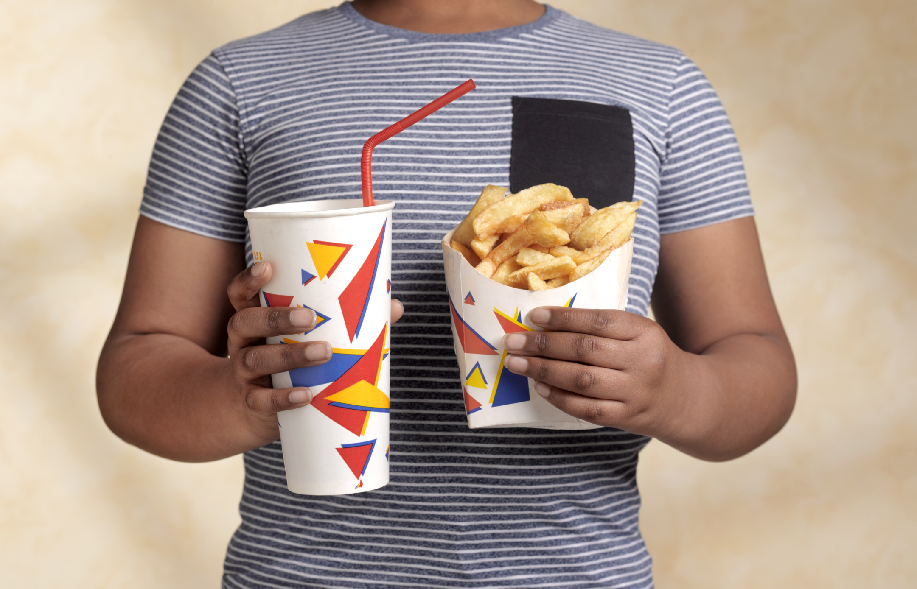

Problem
Internet & online world
Heavy academic workload
Childhood obesity and diabetes
reluctant & lack of interest
Teenagers lack physical activity
Goal: Help teenagers build doctor-recommended exercising habits.

Slide 3
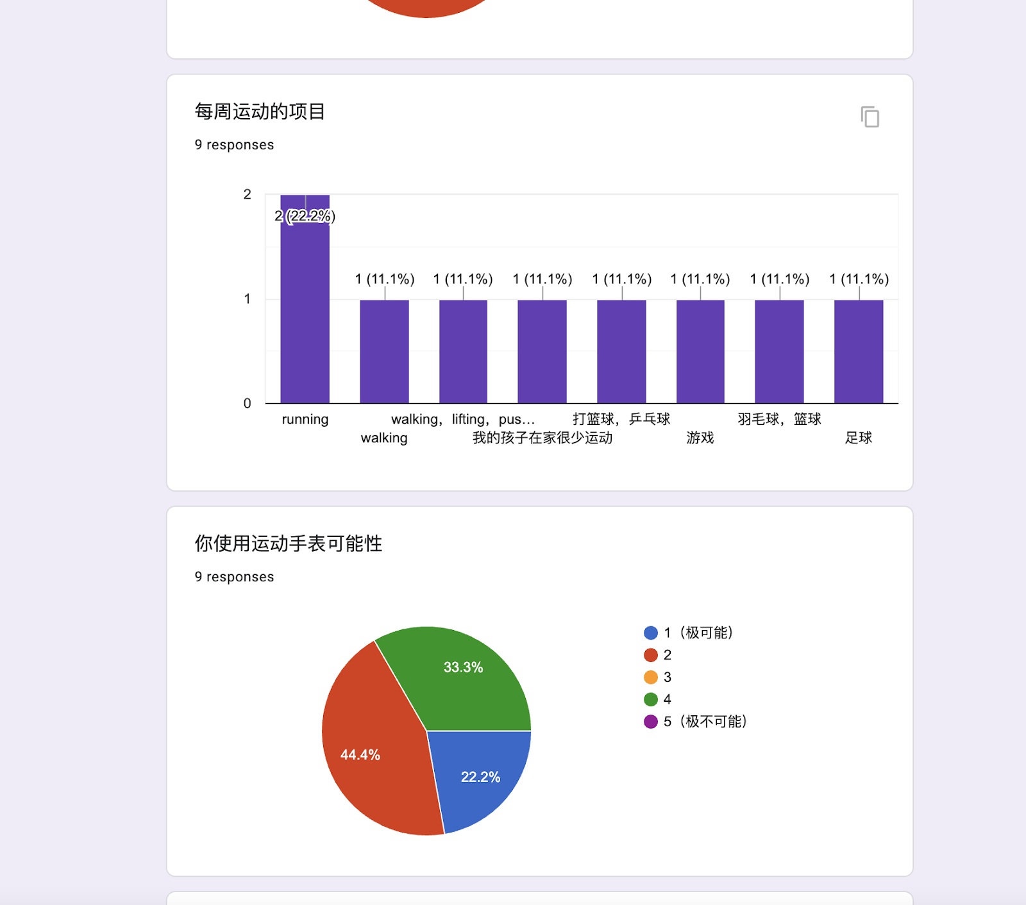
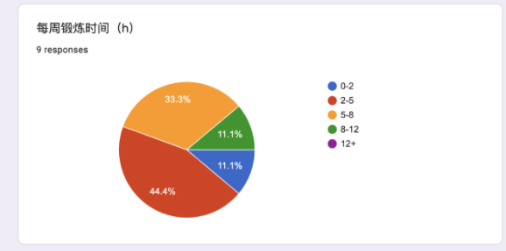
Data Collection
Primary stakeholders
Chinese teenagers age 10-18
Secondary stakeholders
Teachers and parents
Survey
For Teenagers:
Exercise time, school activities, attitudes
For Parents & teachers:
Observation of child/students and attitudes
Interview
In-depth opinions, suggested improvements and reasons
Observation
Investigation of student activities at school

Slide 4
Insights & Design Criteria
Motivation
Focus more on academics
Teenagers lack motivation, “waste of time”
Attract, encourage, and motivate users to exercise regularly.
Customizable
School activities are tedious
Does not satisfy individual need
Recommend users to perform exercising activities that are based on their health conditions and individual needs.
Social
Teenagers are more likely to exercise with friends/group
Connects users and encourages them to create and participate in exercising activities with each other.
Preference
Cell phone prohibition
Different device preferences
A cross-platform product that includes the above basic essential features.

Slide 5
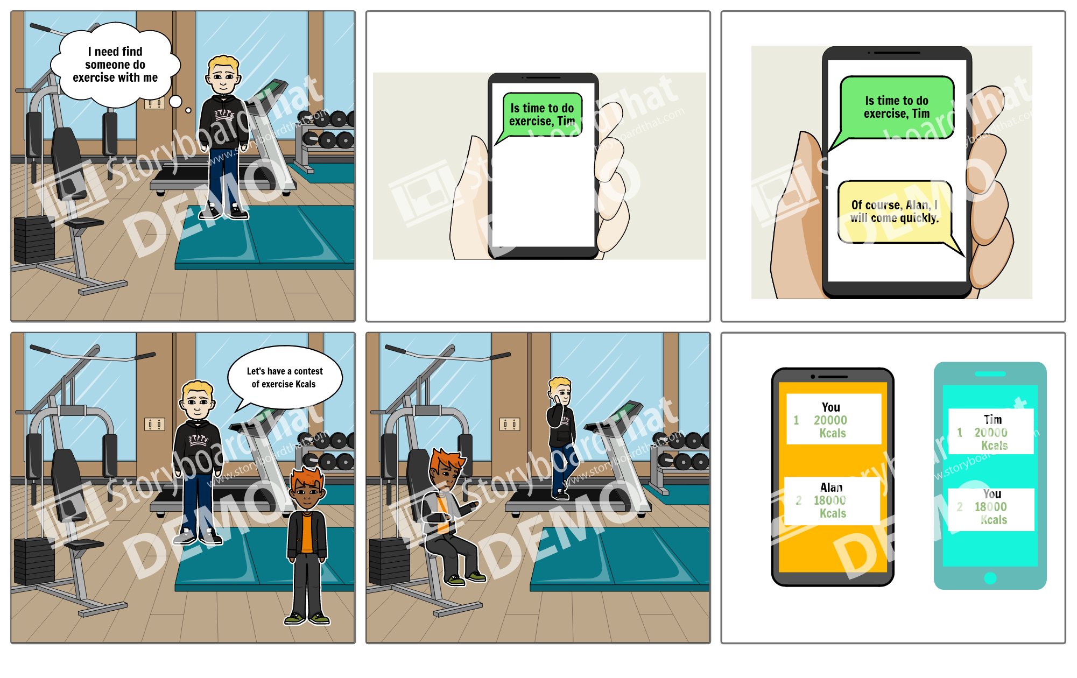
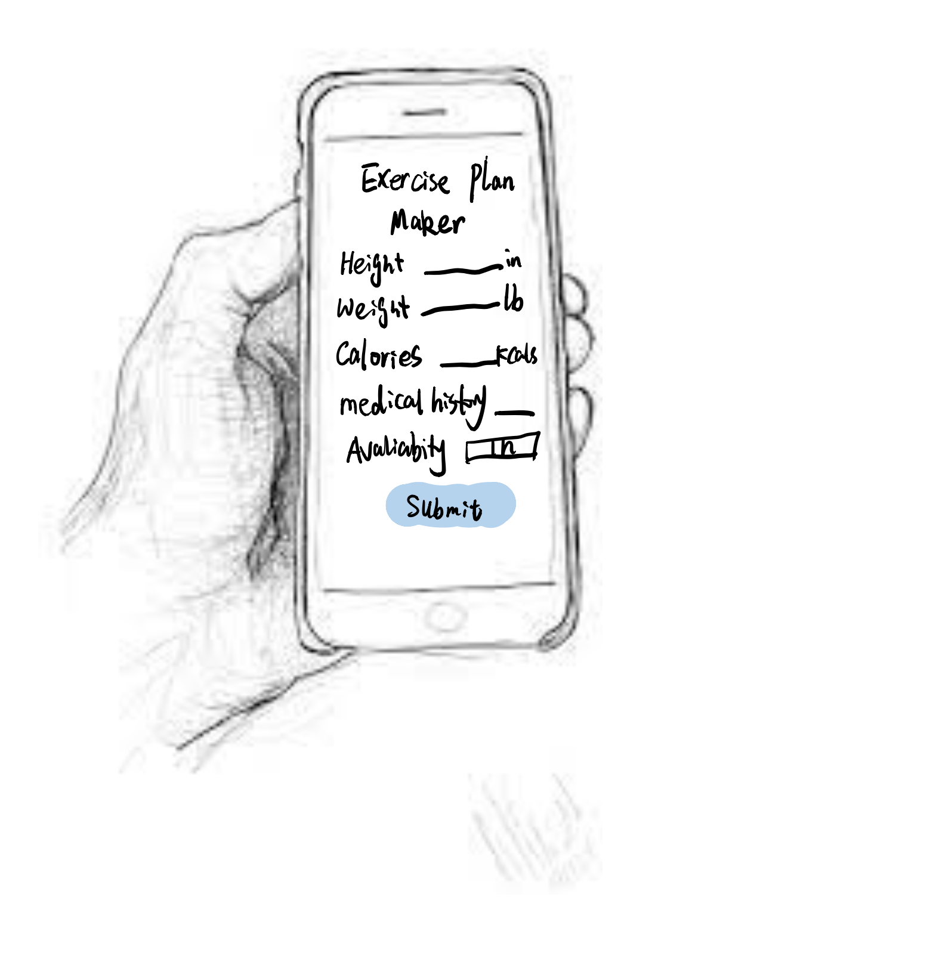
Low-fidelity prototype
Storyboard: Sketch:

Slide 6
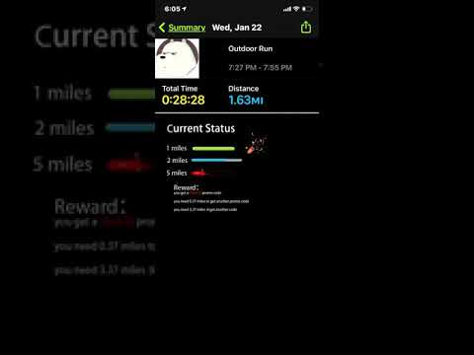
High-fidelity prototype(video)
Reward system
User has different level of goals,
User can get promo code in different level

Slide 7
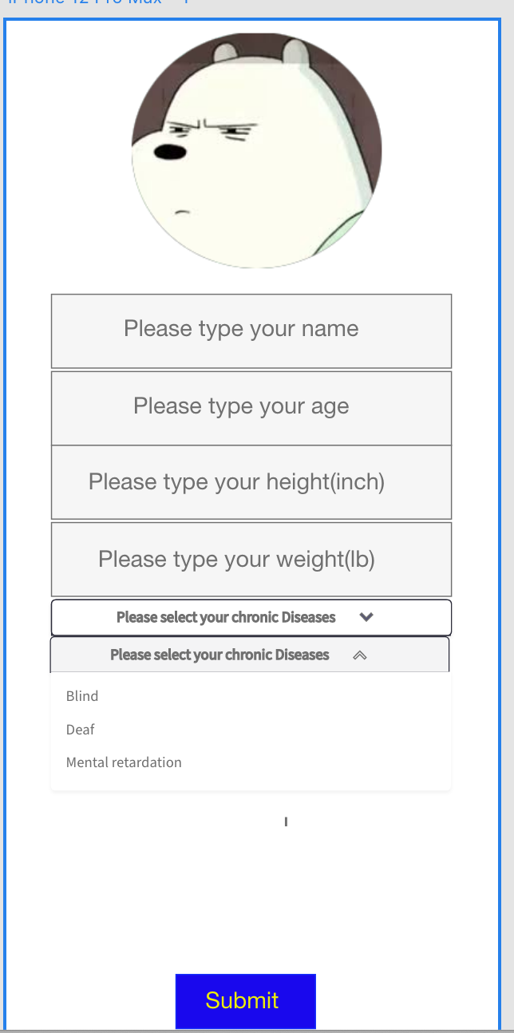
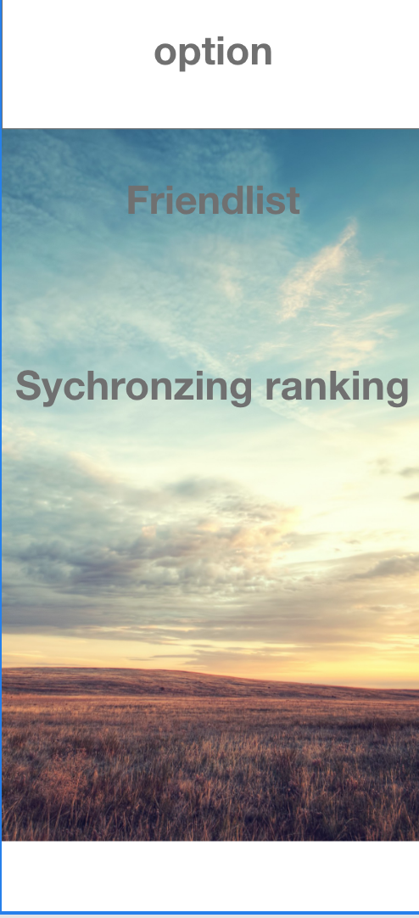
High-fidelity prototype(Clickable)
Customer Intelligence Exercise Plan based on the information provided.
Link
Social interaction of the exercise can check the leaderboard of the exercise and communicate with others who also are doing exercise
Link

Slide 8
Evaluation
Heuristic:
It is unclear where the user was suppose to click in order to get the chick-fil-a coupon to appear
there should be a seperate screen for you to access the coupons rather than showing the coupon on the same screen as the work out stats page
Users should be able to select the rewards they want, and it can have rewards that are more general for everyone to use or allow users to choose one item out of multiple rewards
Can provide another type of reward rather than coupons
Some heading makes some confusion. For example, Current status as a heading was confusing, instead maybe it could be: Goal status. Reward: as a heading was also confusing, maybe it could be changed to "Next reward when..."
It suggested that display current status with reward next to each completed goal
Current Status might need to be reworded into something like "Current Tasks" or "Your Tasks"
The reward button and details are way too small for my poor eyesight
Users should have options to go back on each stage
Might need to provide onboarding for new users
The prototype didn't include errors and incorporate help
The evaluator want to see other people's achievement and their daily activities.
the UI can be more consistent with the other prototypes.
font size can be better
the rewards can be workout equipments
it's hard to track some exercises and maybe people can cheat to get reward
maybe you can list the reward for each milestone the user make
Walkthrough
There should be a "None of the above" option for people with a different diseases
There should be a "None of the above option" for people with a different disability
Some submit button is unclickable
There should be a send button :) Using enter is not intuitive
Only one emojis are support, other emojis is unclickable

Slide 9
Evaluation
Improvement point
We can add a send button in the first clickable prototype
Add a None choice in disability and diseases
Make each chat page is support in emojis function
Make a instruction for users to get know what function is support in prototypes
Make sure the second clickable prototype’s submit button is clickable
Change the font size of the video prototype
Add more type of rewards of the video prototype and give the choice of the users
list the reward for each milestone the user make in video prototype
For video prototype,make a seperate screen for you to access the coupons rather than showing the coupon on the same screen as the work out stats page
Change some headings in the video prototype to make sure it more understandable
Display current status with reward next to each completed goal in video prototype
Current Status might need to be reworded to Current Tasks
The reward button and details make large to make people to easily read
Achieve the video prototype have function that users can have options to go back on each stage
include errors and incorporate help in video prototype

Slide 10
reflection

